Slide 1
Background Removal
Using PowerPoint

Slide 2
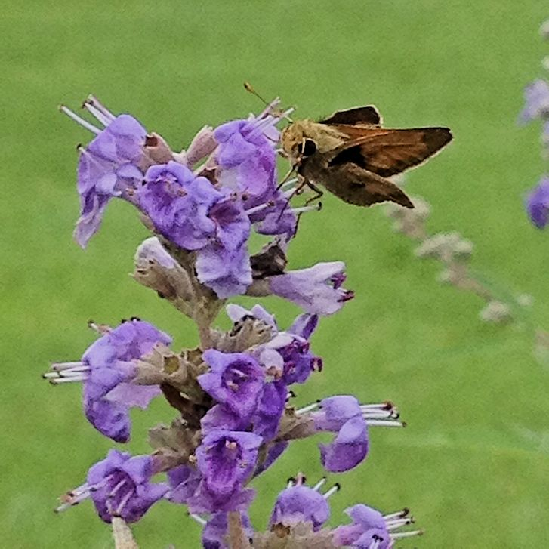
Original Photograph

Slide 3
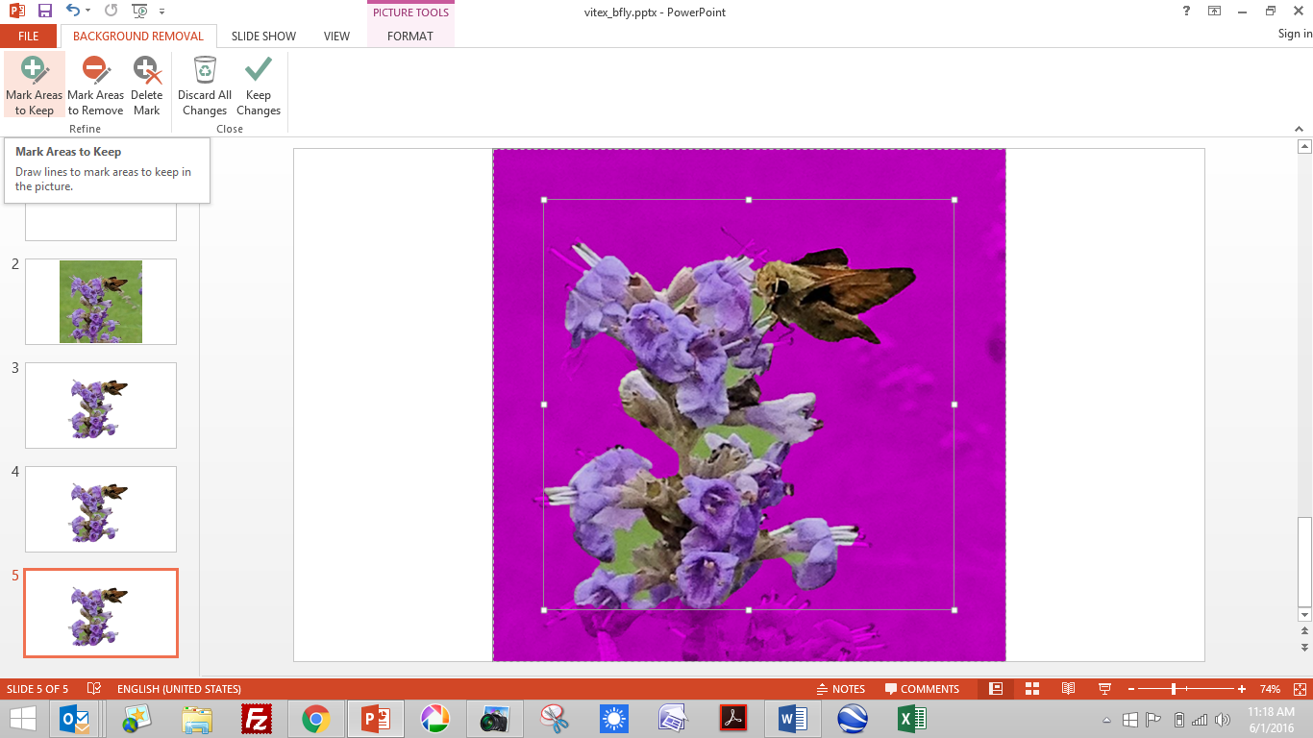
Photograph After Selecting “Remove Background”

Slide 4
Photograph After Selecting “Save Changes”

Slide 5
The End ~
Finis

